Slide 1


Nuclear Lattice Effective Field Theory
Young-Ho Song (중이온가속기연구소, IBS)
NLEFT collaboration
거대계산 워킹그룹 미팅, 2023.03.28, IBS

Slide 2
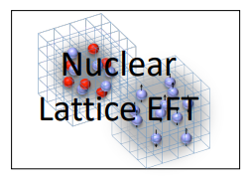
Nuclear Lattice Effective Field Theory Collaboration
Serdar Elhatisari(Gaziantep Islam Science and Technology)
Lukas Bovermann(Ruhr)
Evgeny Epelbaum (Bochum)
Dillon Frame (Juelich)
Fabian Hildenbrand(Darmstadt)
Hermann Krebs(Ruhr)
Timo A. Lähde (Juelich)
Dean Lee (MSU)
Ning Li(Sun Yat-sen)
Bing-Nan Lu( Graduate School of China Academy of Engineering Physic)
Myungkuk Kim(CENS,IBS)
Youngman Kim (중이온가속기연구소,IBS)
Young-Ho Song(중이온가속기연구소,IBS)
Yuanzhuo Ma(Peking)
Ulf-G. Meißner (Bonn/Juelich)
Gautam Rupak(Mississippi State)
Shihang Shen (Juelich)
Gianluca Stellin( CEA Paris-Saclay)

Slide 3
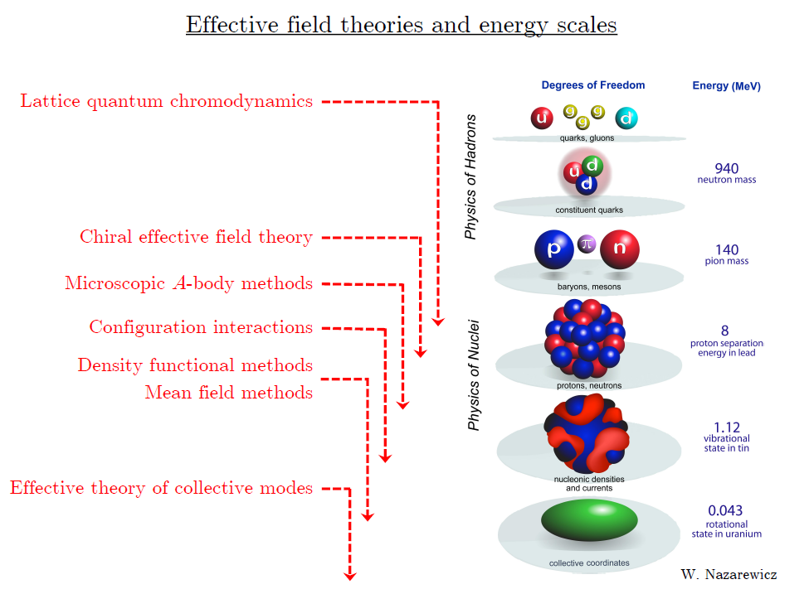
Ab initio
Nuclear
Theory

Slide 4
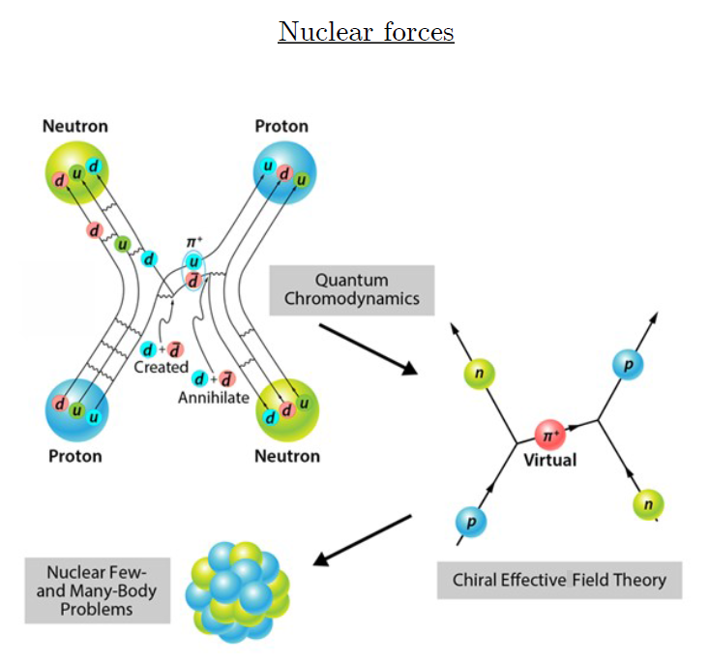
Ab-initio method
Ab-initio can mean many different things.
ab-initio Nuclear Physics
(1) nucleon degrees of freedom
(2) nucleon-nucleon interaction
Goal: predict nuclear phenomena (without parameter fitting) from fundamental nuclear interaction.
→ rare isotopes, dripline,
r-process,
extreme conditions

Slide 5
Ab initio many-body
(ab initio) Nuclear physics is challenging.
Nuclear many body problem
Requires Non-perturbative method.
Ab-initio nuclear many body methods
Greens function Monte Carlo(GFMC)
No-core shell model(NCSM)
Coupled Cluster (CC)
IM-SRG, VS-SRG
Nuclear Lattice Effective Field Theory(NLEFT)
And more
With recent progress in ab-initio methods
Binding energies for wide range of nuclei
Some reaction calculation for light nuclei.

Slide 6
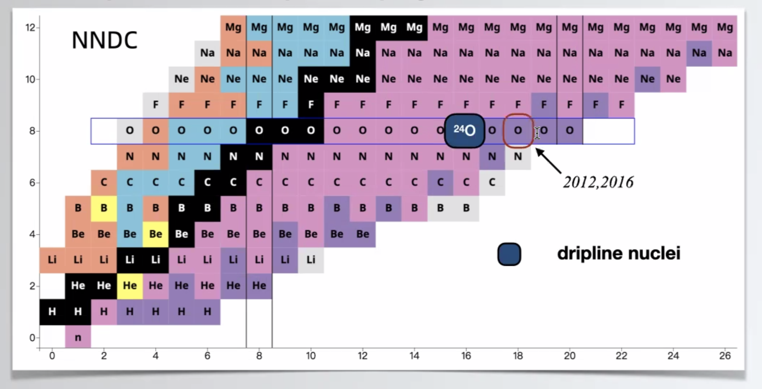
Oxygen isotopes
Can we explain the dripline of Oxygen isotopes in NLEFT?
Role of 3-body force?

Slide 7
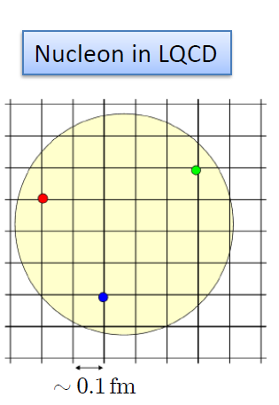
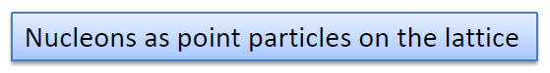
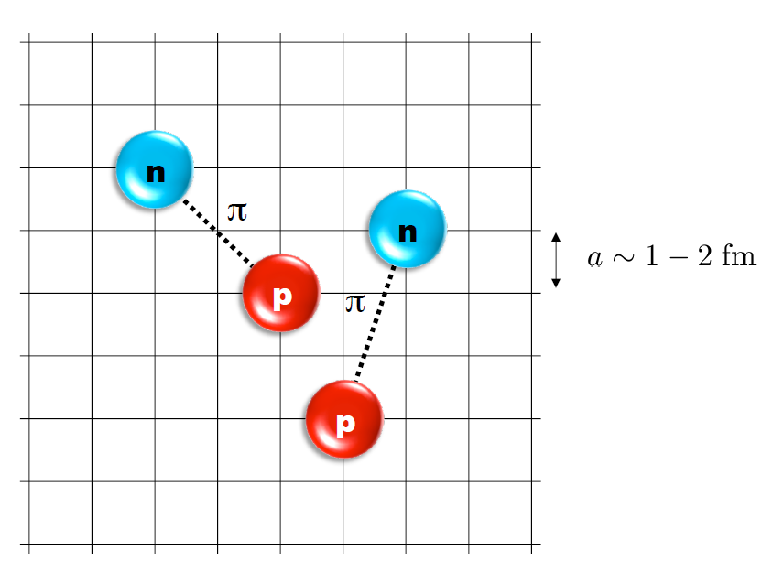
Nuclear Lattice Effective Field Theory
One of ab initio method for many fermion system

Slide 8
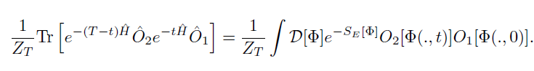
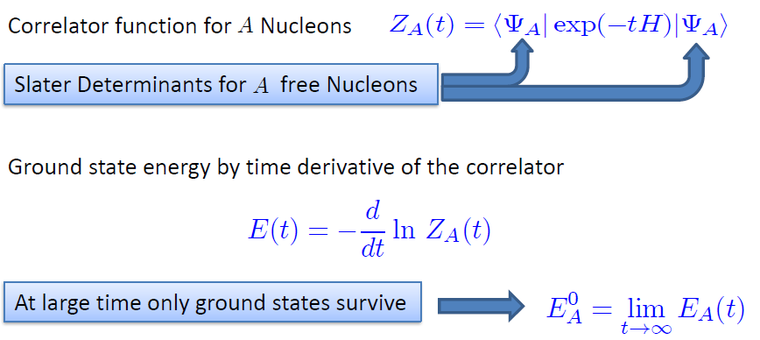
Path integral

Slide 9
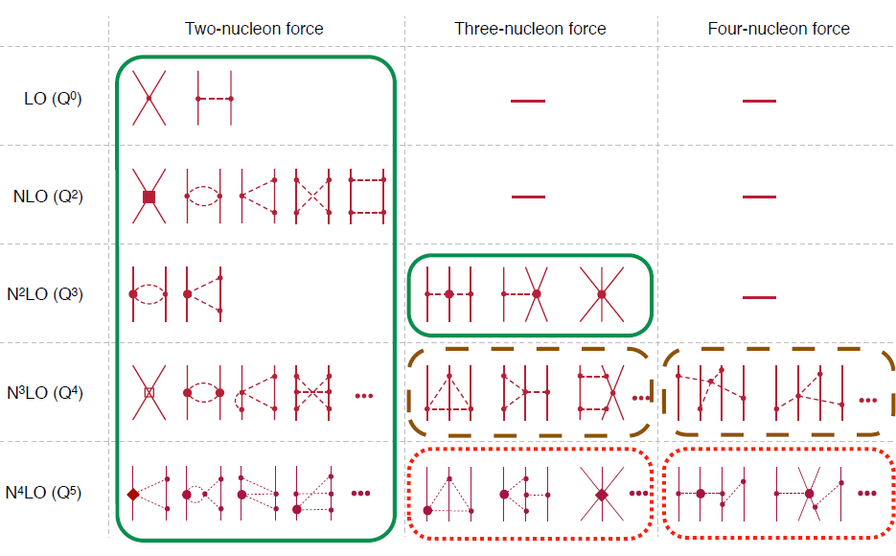
Chiral Effective Field Theory

Slide 10
Lattice Hamiltonian
We need to introduce a lattice scale in space and time:
momentum space cutoff ~ 150 MeV → lattice size a= 1.316 fm
Time cutoff ~ 1000 MeV
We need to determine coefficients of interaction for the lattice size. (regularization scale.)
Two-body interaction coefficients can be determined from phase shifts of np scattering.
Three-body interaction can be fixed from binding energy of A>=3.

Slide 11
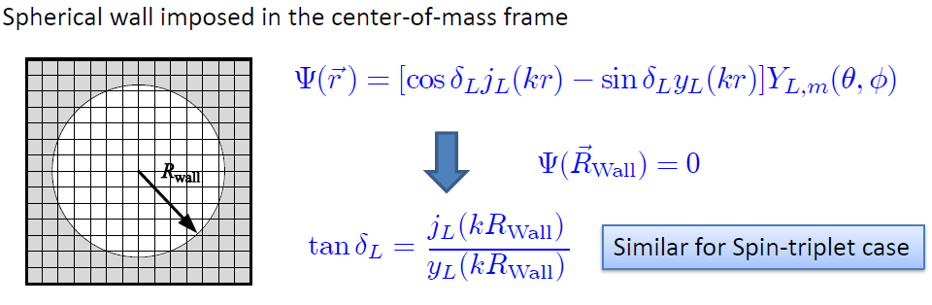
Low energy constants in lattice EFT
All LECs(parameters in the Hamiltonian) are fixed in A<=3
(They have to be fixed for given lattice regularization)
N-P scattering phase shifts, Deuteron binding energy
Triton binding energy, Triton beta decay.
Scattering phase shifts on the Lattice: Wall method.

Slide 12
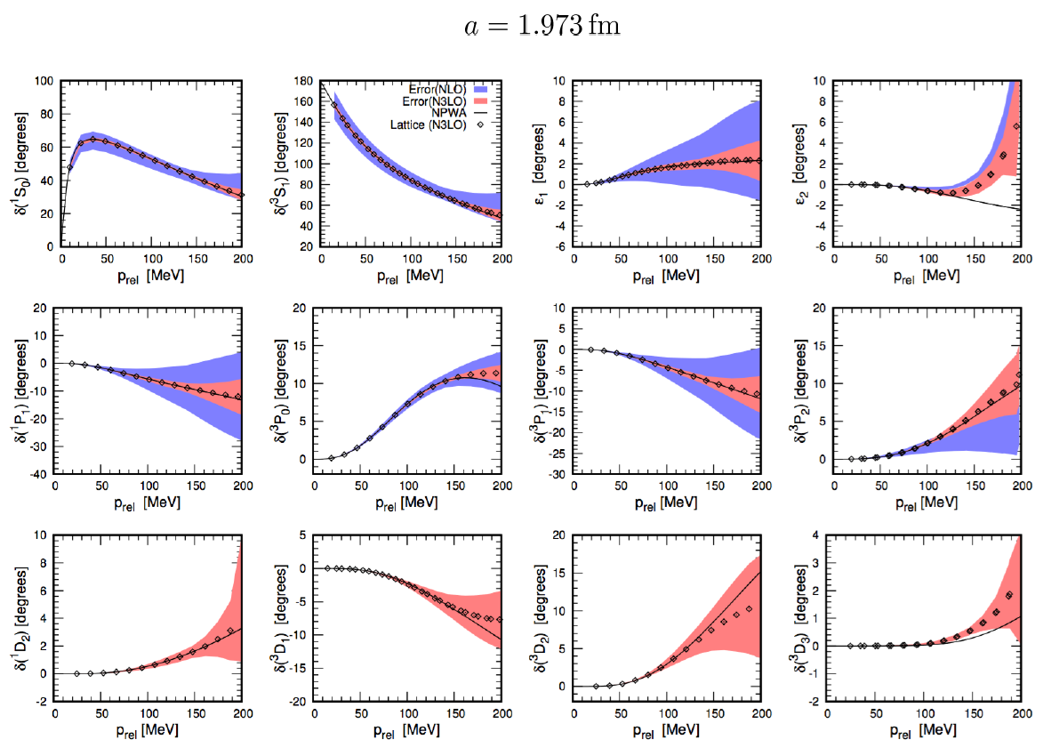
Determine LECs by fitting phase shifts of N-N scattering

Slide 13
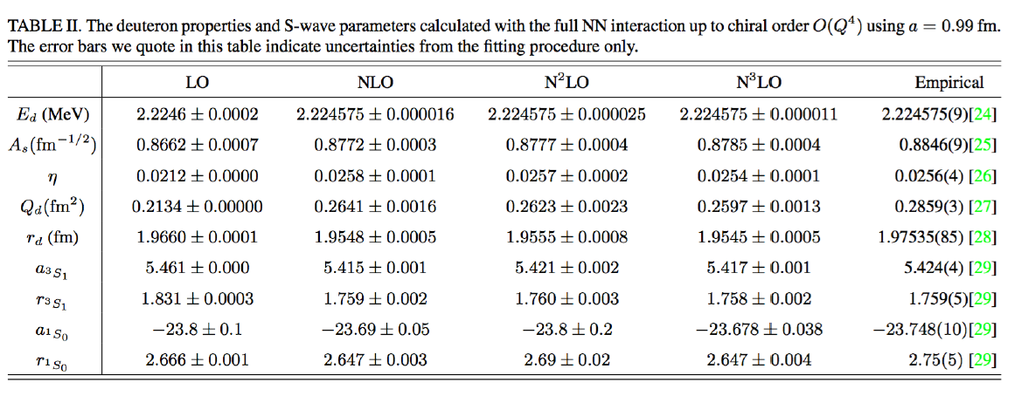

Slide 14
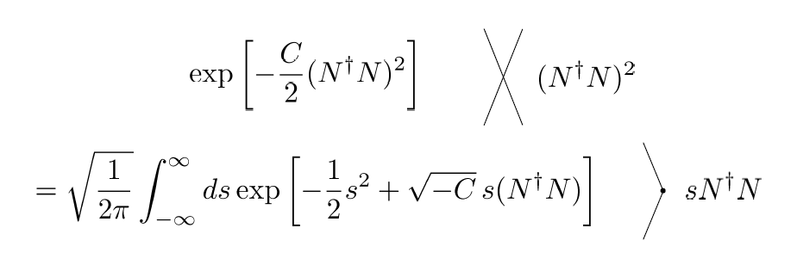
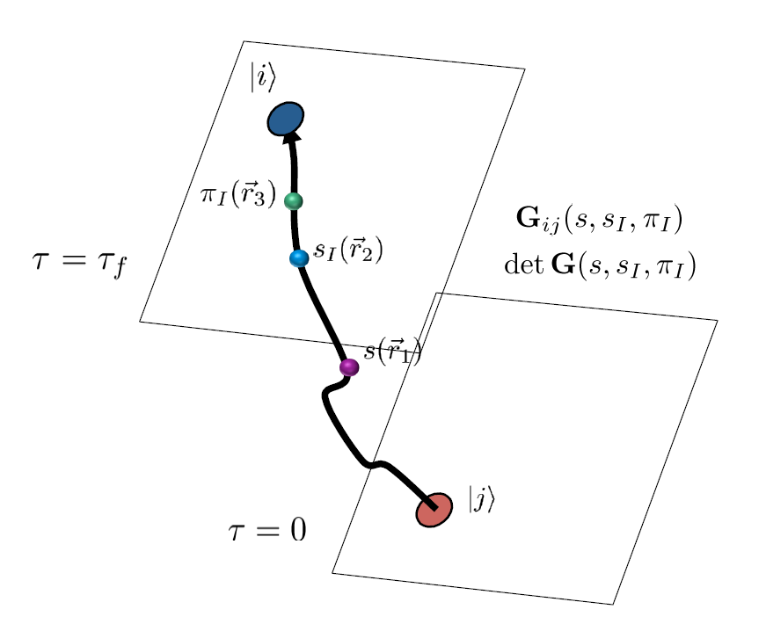
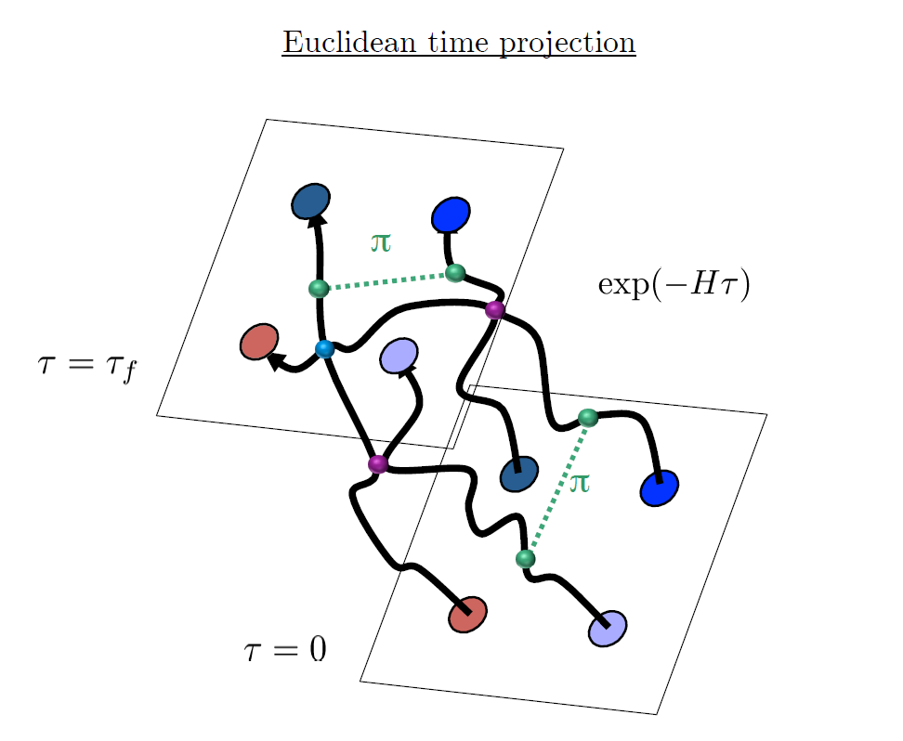
Auxiliary Field Monte Carlo

Slide 15
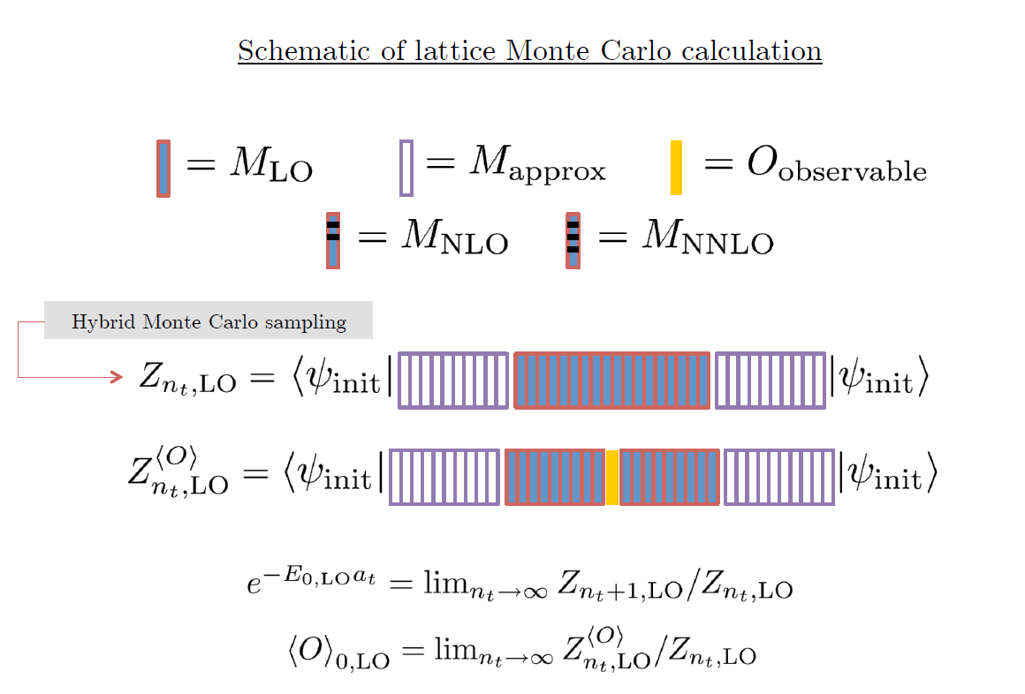

Slide 16
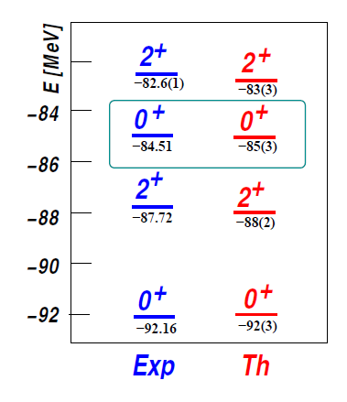
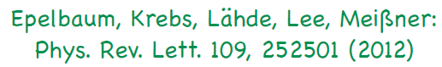
Applications of NLEFT
Has been successfully applied to
Nuclear matter, Cold atom, dilute fermion system
Finite nuclei (A<=50)
First ab-initio calculation of Hoyle state
Cluster structure of ¹²C and ¹⁶O
NN scattering, N-D scattering
Alpha-alpha scattering
radiative capture, fusion
Etc.
The first ab-initio calculation of
Hoyle state

Slide 17
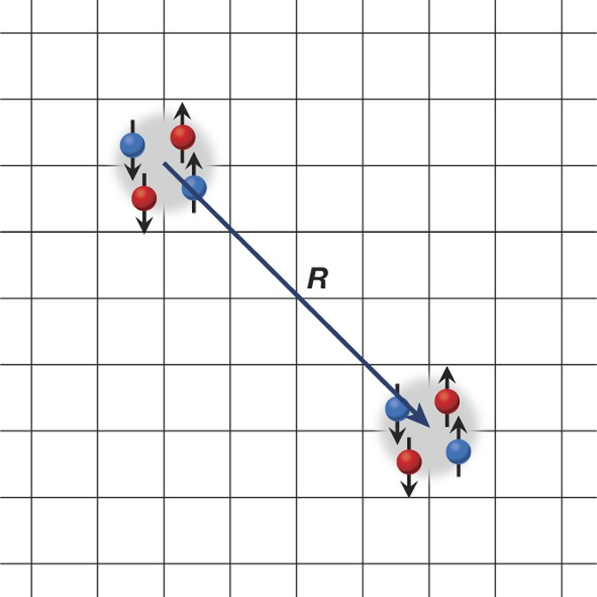
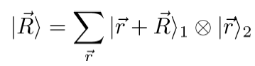
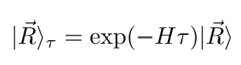
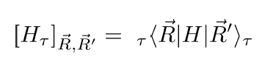
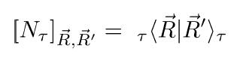
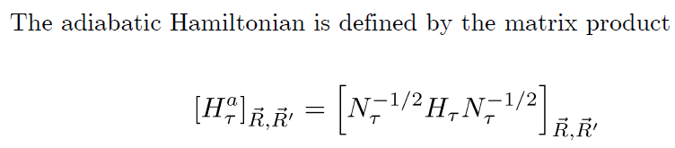
Adiabatic projection method
Construction of effective Hamiltonian
between two clusters

Slide 18
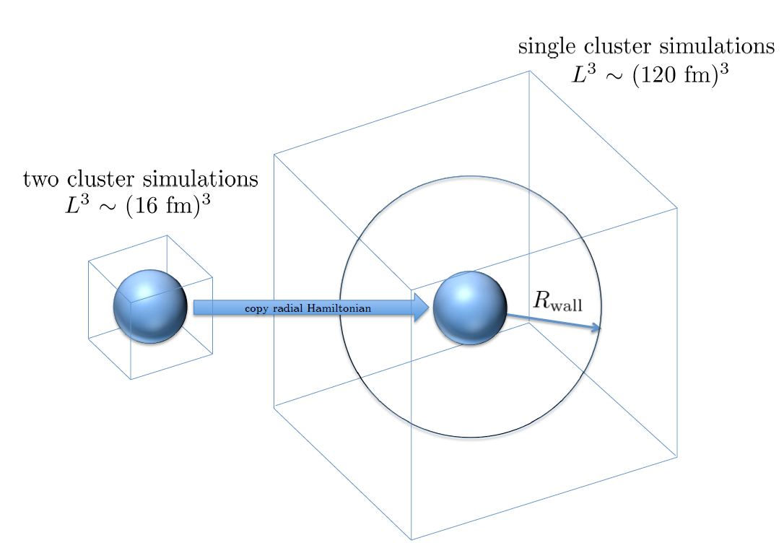

Slide 19
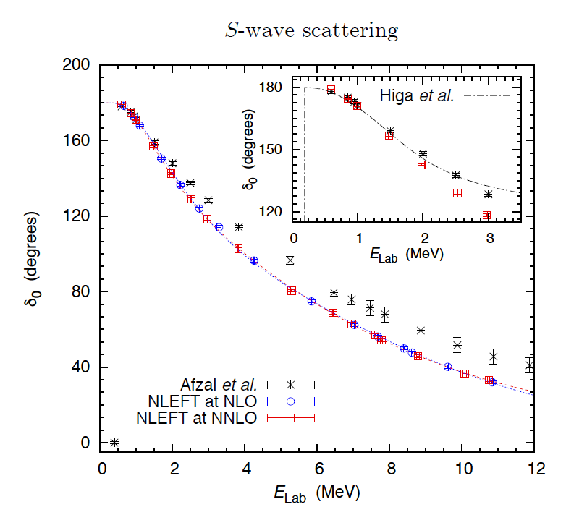
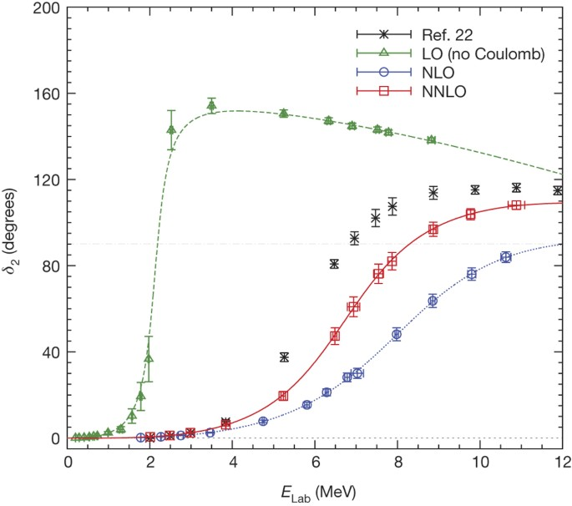
Adiabatic projection method
Ab initio alpha-alpha scattering
( Nature 528, 111-114(2015))

Slide 20
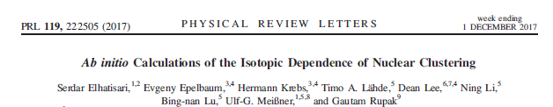
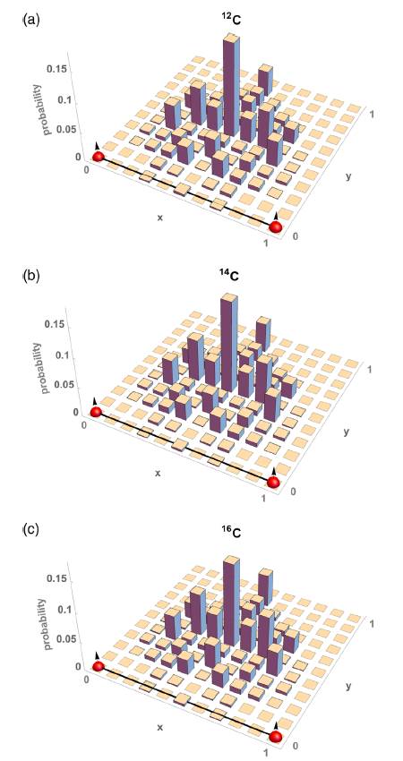
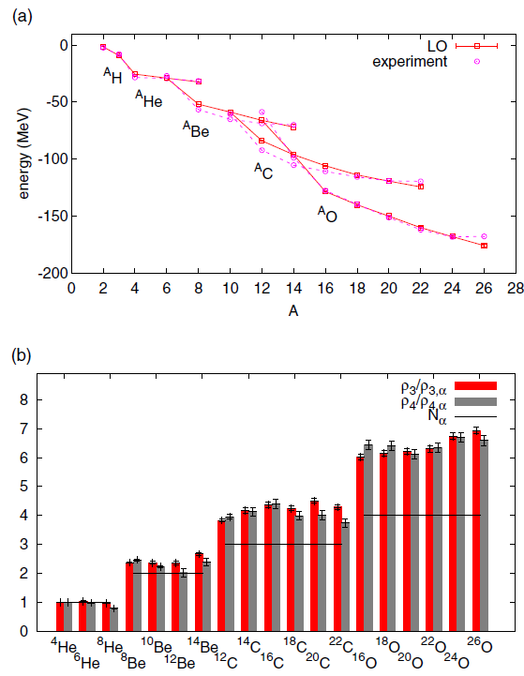
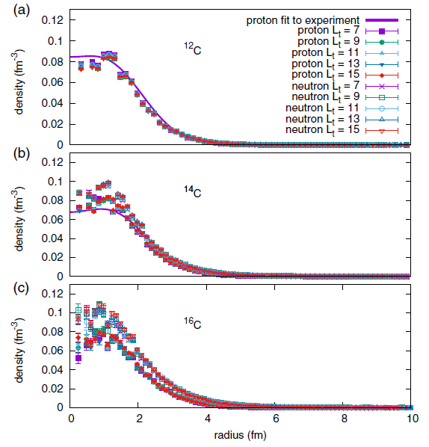
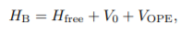
Pinhole algorithm

Slide 21
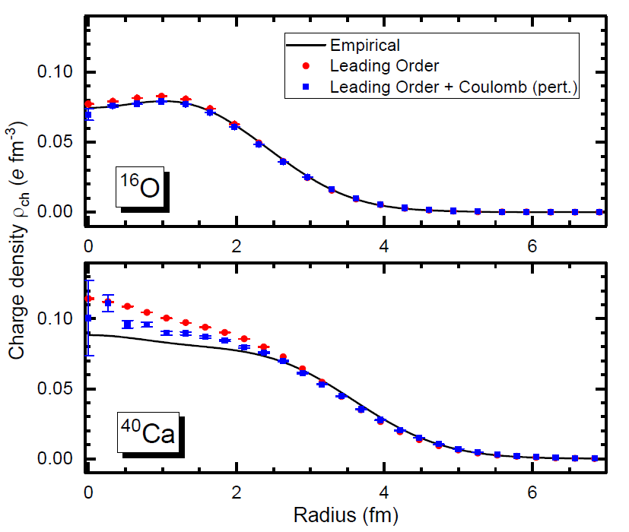
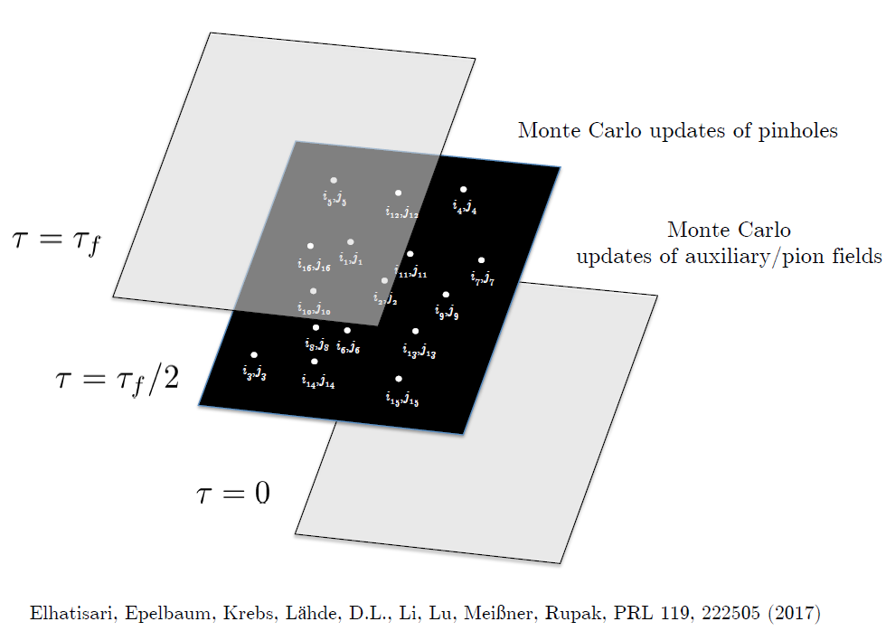
Pinhole Algorithm

Slide 22
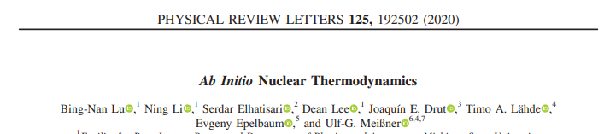
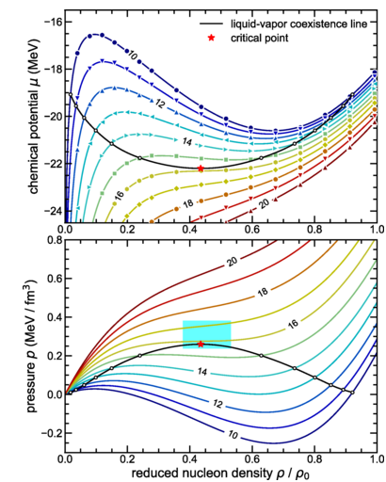
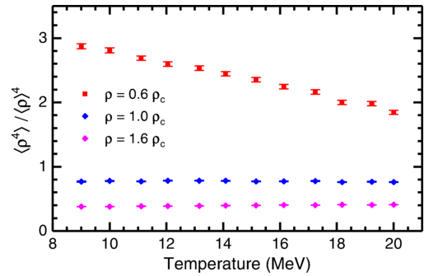
determine the location of the critical point
and the liquid-vapor coexistence line
for symmetric nuclear matter
with equal numbers of protons and neutrons.
the first ab initio study of the density
and temperature dependence of nuclear clustering.
Pinhole trace algorithm

Slide 23
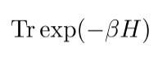
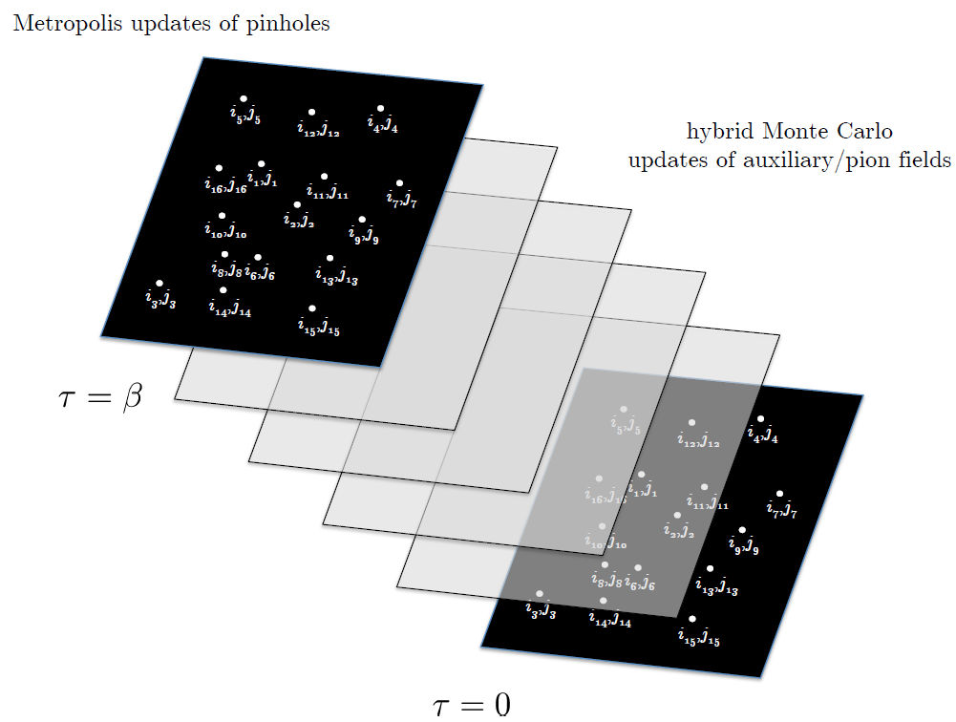
Pinhole trace algorithm

Slide 24
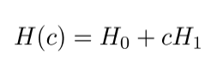
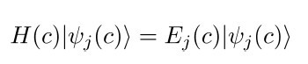
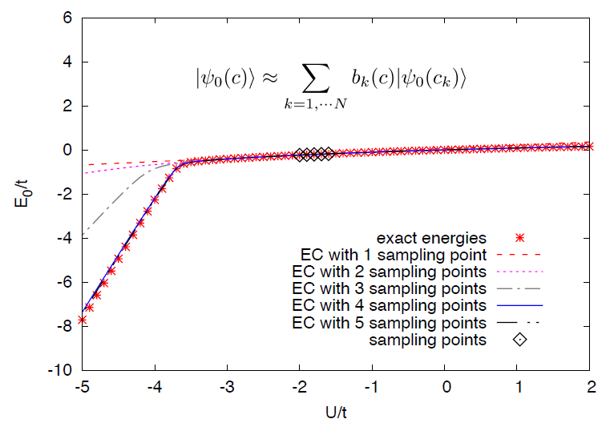
Eigenvector Continuation
extrapolate/interpolate Hamiltonian
With parameter c.
Express eigen-vector in small basis space
Result for Bose-Hubbard model in 3D
(three bosons)

Slide 25
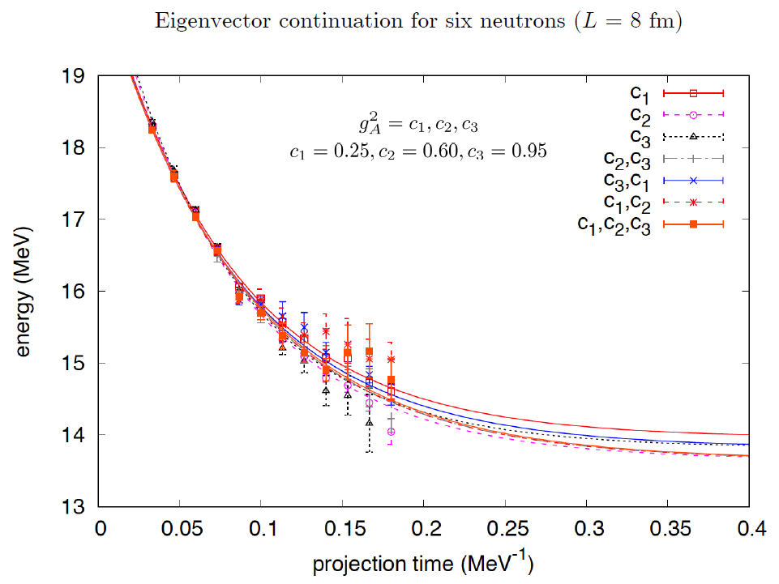
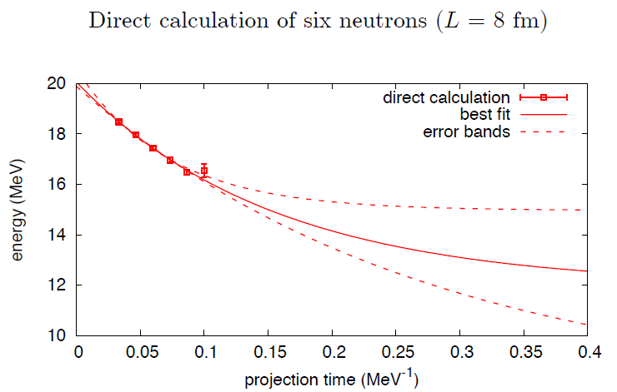
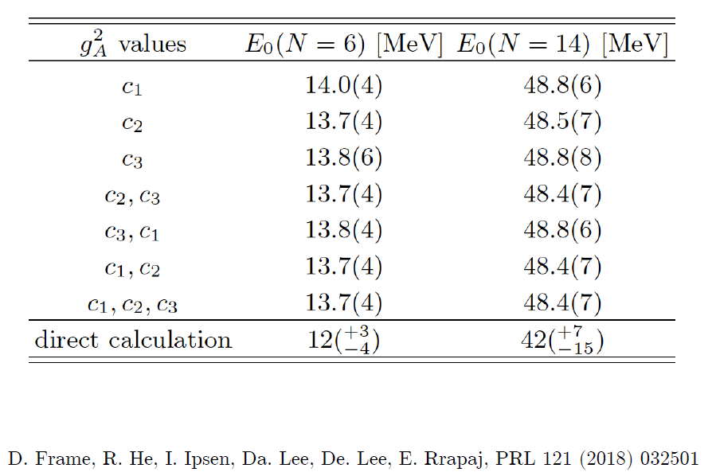
Eigenvector Continuation
Neutron matter calculation

Slide 26
Eigenvector Continuation

Slide 27
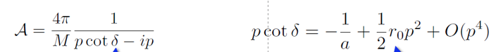
Unitary Fermion Gas
Physically Interesting multi-fermion system which is easier to approach
→ Unitary limit fermion system: a strongly coupled conformal system.
p $\cot{δ}=0$ : Unitary limit
→largest possible scattering amplitude
Infinite scattering length.
Zero effective range.
( Realistic nuclear force is close to unitary limit.)

Slide 28
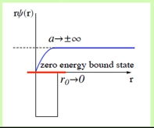
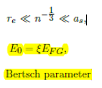
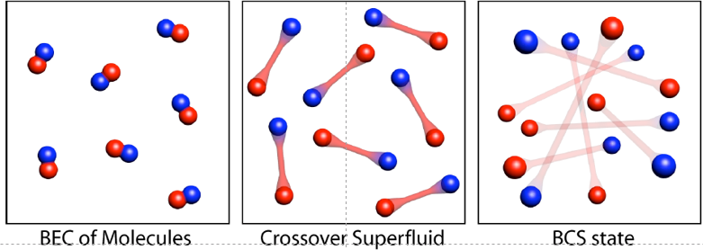
Unitary Fermion Gas
Universality of unitary limit
Of many fermion system
→ Bertsch Parameter
Experiment in
Ultracold trapped atoms
(M. J. H. Ku et al, Science 335, 563-567 (2012).)
Bertch parameter ~ 0.376(4)
Many theoretical calculation exists including NLEFT.
Previous NLEFT calculation was done in cubic lattice.
Here we applied NLEFT in BCC lattice .

Slide 29


(M. J. H. Ku et al, Science 335, 563-567 (2012).)
Bertch parameter ~ 0.376(4)
Chemical potential, energy, free energy and Entropy per particle

Slide 30

Unitary limit Hamiltonian in BCC
Because of convenience, all NLEFT calculation has been done on cubic lattice
Physical result should not depends on the specific lattice structure. (lattice size, spacing, type)
BCC lattice is constructed as Two cubic lattice
(shifted by (1/2,1/2,1/2) in lattice unit)
2 L^3 lattice points
Lattice spacing a=1/100 MeV^-1
Lattice Time step at = 1/1000 MeV^-1
(For outer region at’=1/200 MeV^-1)

Slide 31





Unitary limit Hamiltonian in BCC
Our choice is valid up to O(p^6) : f(p) = p^2 +O(p^6)

Slide 32



Unitary limit Hamiltonian in BCC
Non-local smeared
Contact interaction
1S0 NN scattering phase shift is fitted
For unitary limit .
C0= -0.7449172 [l.u.]
sNL = - 0.0009533729
→
a0 = 125658 fm, r0 = 0.110 fm
Spherical Wall Method

Slide 33




Unitary Fermion Gas in BCC lattice
N=66 neutrons (33 spin up, 33 spin down)
L = 4,…, 10
Cubic lattice

Slide 34



Improved action with non-locality
In practical calculation, sign problem and convergence of perturbation have to be taken care of.
To improve the non-perturbative calculation, modified non-local contact interaction are used.

Slide 35
Lattice chiral Hamiltonian (N3LO)
Full N3LO Hamiltonian includes
Free Hamiltonian(Kinetic term)
Short range (nonlocal smeared) contact interactions up to Q^4 order
Isospin-breaking short range interactions
One pion exchange potential
Two pion exchange potential up to Q^4 order
Coulomb interaction
Long range isospin breaking interaction( isospin dependence in OPE)
Galilean Invariance Restoration (GIR) term (because of non-local interaction.)
Three nucleon interaction

Slide 36
Difficulty with full chiral interaction
Sign problem
NLEFT suffers sign problems at large Euclidean time limit
Large cancellation between positive and negative contributions→ large uncertainty.
SU(4) symmetric interaction does not have sign problem
One pion exchange and higher order chiral interaction
Difficulty with Asymmetric nuclei
Needs a remedy to extend to neutron rich isotopes.
A new approach to reduce the sign problem.
→ Wave function matching Hamiltonian.

Slide 37





Minimal nuclear interaction
Which reproduce
Light nuclei
medium mass nuclei
neutron matter
simultaneously up to few percent error in binding energy and charge radius
Only Four parameters

Slide 38


Can we improve the agreement by
Including higher order corrections?

Slide 39


Can we improve the agreement by
Including higher order corrections?

Slide 40


Slide 41




Wave function matching
H and H’ are fully equivalent to two-body observables
The goal is to make the perturbation expansion from “simple” wave function gives a good convergence
U is only active
At r < R

Slide 42

NN phase shifts from WFM
Original Hamiltonian is fitted to phase shifts.
H’ is equivalent to original Hamiltonian.

Slide 43
Deuteron
Original and transformed Hamiltonian gives correct deuteron binding energy for non-perturbative calculation.
H_s is chosen as a leading order of H
Non-perturbative H_s + first order perturbation (H’-H_s)
→ 2.02 MeV .
→ 0.1MeV/nucleon error is attributed to higher order (H’-H_s) correction
Non-perturbative H_s + first order perturbation (H-H_s)
→ 0.68 MeV
→ worse convergence
Preliminary

Slide 44

Tjon line
Correlation between 3H and 4He binding energy.
Two nucleon interaction only.
Open symbols: chiral EFT
(non-perturbative LO
+ perturbative higher orders)
filled symbols: W.M.
(non-perturbative H’
+perturbative corrections)
Preliminary

Slide 45
Three-body force
No new LECs in 2-body interaction
→ We chose H_s as leading order of chiral EFT potential.
Drawback : Induces many body interactions
→ introduce additional 3-body interactions and fit them.
Chiral EFT TBF at N2LO have two parameters: cD, cE
at N3LO have many-diagrams, but no new parameter.
4 new parameters for TBF at N3LO:
local smeared cD
local smeared cE
point-split cE_1, cE_2
a fine-tuning of α-α S-wave scattering, α-N scattering, α-N-N scattering, α-α-α scattering,
more TBF terms only give minor improvements.

Slide 46

BE/A from WFM
Preliminary

Slide 47



Charge density from WFM
Preliminary

Slide 48

Charge Radius
Preliminary

Slide 49

Nuclear/Neutron Matter
Neutron matter:
A=4~80
box size 6.6 ~ 13.2 fm.
Nuclear matter:
A=4 ~ 160
Box size 7.92~9.24 fm.
Preliminary

Slide 50

Oxygen isotopes in NLEFT
Reasonable agreement with experiments
Correct dripline at O24
Slight over binding in O26.
→ finite volume effects?
Preliminary

Slide 51

Carbon isotopes

Slide 52
Summary
Wave function matching method seems to be promising
New method to improve the N3LO calculation of NLEFT
Preliminary study shows promising results for wide range of observables
NN scattering
Binding energy (from 3H to 40Ca)
Symmetric Nuclear matter
Neutron matter
Dripline of Oxygen isotope.
Carbon excited states
Further investigation on the finite volume effects is on-going.
Also, Carbon isotopes, odd Oxygen isotopes, Cluster structure, excited states will be studied.

